Slide 1
Secure Your Liferay DXP Platform
Liferay DXP Basics
Business
Liferay DXP 7.4

Slide 2
Key Module Takeaways
Multi-Factor authentication, SSO, and other User authentication methods can be configured for Users to sign into Liferay DXP.
To secure web service, Liferay DXP provides four security layers: IP permission, service access policy, authentication/verification, and User permission.
Files, documents, and media can be secured by enabling an antivirus scanner.

Slide 3
Exercise Prerequisites
Unzipped module exercise files in the following folder structure:
Windows: C:\liferay
Unix Systems: [user-home]/liferay
Liferay DXP 7.4 set up and running
If you have not started your Liferay instance yet, set it up with the following basic configuration:
Mondego Publications Site created with a Community page and Message Board added
Portal Name: Mondego
First Name: Test
Last Name: Test
Email: test@modego.com
Notes:
Check out the following modules for more information:
Build New Sites with Liferay DXP for information on creating the Publications Site
Add Users and Manage Permissions for information on Organizations
Liferay Foundations: Introduction to Liferay DXP for information on starting a new instance of Liferay

Slide 4
Use Case: The Mondego Group
The Mondego Group needs robust security measures on its Site to ensure that company and User information and assets are protected. To ensure the security of its platform, Mondego wants to:
Enable Multi-Factor Authentication
Define permissions and policies for passwords and remote services
Ensure file, document, and media security

Slide 5


Relevant KPIs
Increase account security by configuring multi-factor authentication
Increase platform and document security by enabling antivirus and utilizing other security tools
Reduce the risk of unauthorized access to documents and services

Slide 6
Securing Liferay with User Authentication

Slide 7
Basic User Authentication
In Liferay DXP, the Sign In widget is the default tool for authenticating Users:
The widget uses the instance database to authenticate Users
Users log in using one of the following authentication types:
Screen Name
Email Address
User ID
Notes:
Notes:
Liferay takes a “Secure by Default” approach, so the default security settings for user authentication are enabled with that in mind.
By default, Users sign in with their email address. This can be changed to User ID or Screen Name in the Control Panel under Instance Settings > Platform > User Authentication.
By default, Guest Users can also create an account at the sign in page. This can be disabled as needed.
The three Authentication Types are:
Screen Name: established at account creation and can be changed
Email Address: the default authentication type determined at account creation and can be changed
User ID: automatically generated when account is created and cannot be changed
Keep in mind that only one authentication type can be used at a time to authenticate Users.
Enabling Reminder Queries adds another layer of security when recovering passwords
Use Case:
Mondego has a variety of Sites, both public facing and internal only. For its main public facing Site, Mondego needs Guests to be able to register for an account. Sites used internally, on the other hand, do not allow Guest account creation.

Slide 8
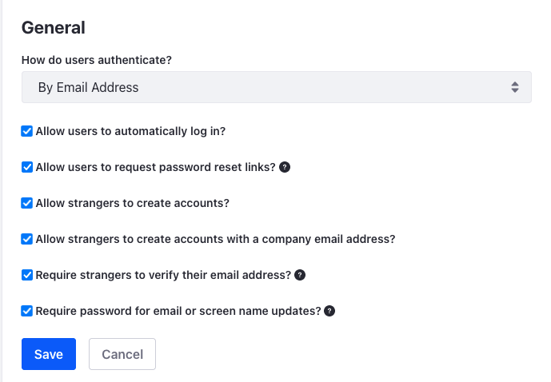
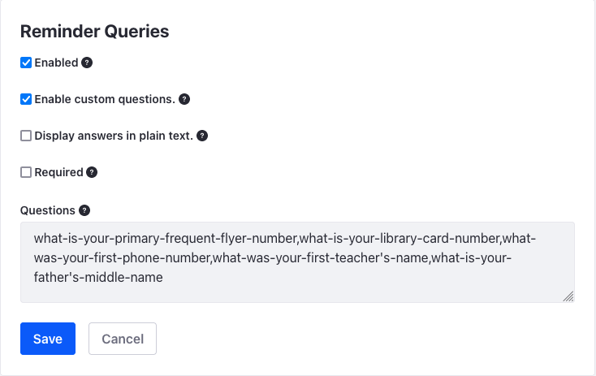
User Authentication Settings
General User Authentication settings include configuring:
Automatic login
Password reset
New account creation
Email verification
Enabling Reminder Queries adds another layer of security when recovering passwords by setting security questions
Notes:
Notes:
You can manage Basic User Authentication Settings in the Control Panel under Instance Settings > Platform > User Authentication. By default, all settings are enabled.
Note: For exercises, we will disable “require email verification” since we will not have a mail server set up.
When enabled, Reminder Queries are used when a User requests password recovery. By default, Reminder Queries and custom questions are enabled.
There is also an option for setting Reserved Credentials which prevents Users from using reserved screen names or emails when they create accounts.
Use Case:
Mondego wants new customers to be able to create accounts but also wants to make sure these are verified users. This can be accomplished by ensuring that ”strangers to create accounts” and “require strangers to verify their email address” are enabled. To add additional security to accounts should Users ever need to recover their accounts, Mondego manage Reminder Queries.

Slide 9
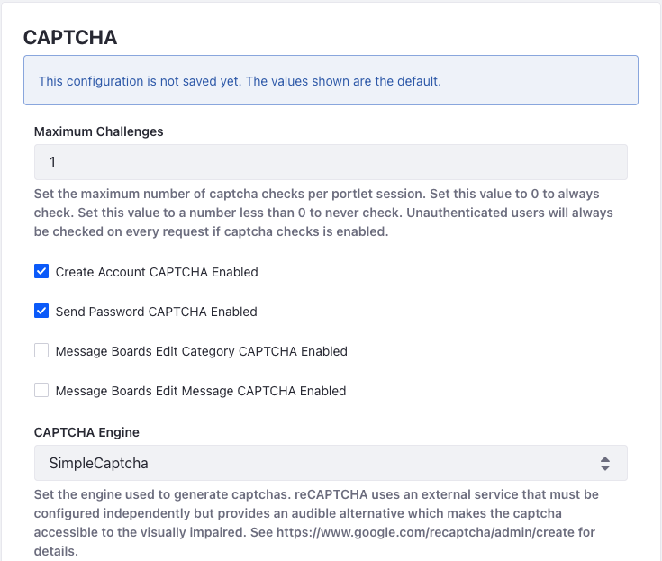
Configuring CAPTCHA or reCAPTCHA
CAPTCHA and reCAPTCHA prevent bots from creating and accessing accounts
By default, Create Account CAPTCHA and Send Password CAPTCHA are enabled in Liferay DXP, both using Simple CAPTCHA
Google’s reCAPTCHA can also be used but requires configuring the external service separately
Notes:
Notes:
To enable or change CAPTCHA settings, go to Control Panel > System Settings > Security Tools.
CAPTCHA can also be enabled for Message Boards and Forms.
Use Case:
By default, any new Users must complete a CAPTCHA when they create a Mondego account. Mondego can manage what kind of CAPTCHA is offered, including opting to use a reCAPTCHA, which includes more accessible options for Users.

Slide 10
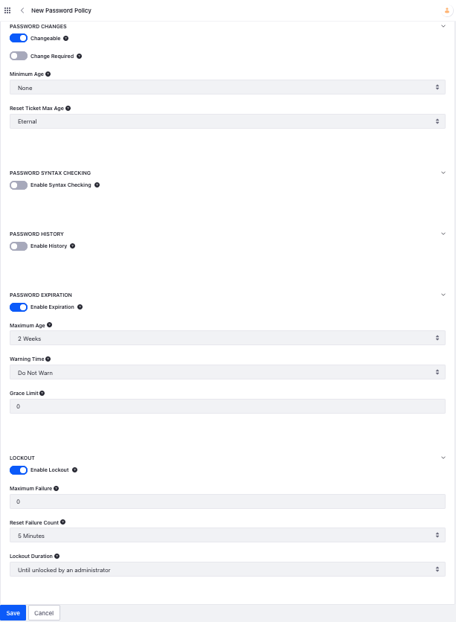
Password Policies
Password Policies add additional security to an instance of Liferay DXP by configuring certain password properties, including:
Password Changes
Password Syntax Checking
Password History
Password Expiration
Lockout
Notes:
Notes:
The password properties include:
Password Changes: allow or prevent password changes, set a time limit for password reset links
Password Syntax Checking: require a certain syntax, disallow dictionary words, set a minimum length, etc.
Password History: set how many passwords to keep in history to prevent old passwords from being reused
Password Expiration: set whether passwords expire and how long passwords are valid, when/whether a warning is sent, grace limit before a forced password change
Lockout: set maximum number of fail attempts before account is locked, how long lockout lasts, how long the number of attempts is stored
Liferay DXP ships with a default password policy that can be modified as needed. By default, all new Users are assigned the default policy. Additional Password Policies can be created. Users must be assigned as members of the new policy in order for it to apply to them.
This is accomplished by using the three-dot menu beside the Policy and selecting Assign Members. Users can be assigned individually or as an Organization.
New Password Policies can also be added to the portal-ext.properties file
Use Case:
Since Mondego handles sensitive information, the company highly recommends strong passwords for all its Users, both internal and external. Some Users are also expected to regularly change their passwords for added security. To ensure that these Users change passwords, Mondego can create a new Password Policy that requires a password change every six months, disallows the use of passwords that have been used in the past two years, and requires that the password consist of at least 10 characters including one symbol, one upper case letter, one lower case letter, and one number.

Slide 11
Authentication Methods
Additional methods for configuring authentication of users and applications in Liferay DXP include:
LDAP
SAML
Kerberos
OpenID Connect
OpenAM (v13 only)
Token-Based Solutions
OAuth 2.0
Multi-Factor Authentication
Notes:
Notes:
Liferay provides options for managing SSO, integrating with LDAP, or configuring Multi-Factor authentication depending on specific instance needs.
LDAP: integrates with an existing LDAP server and authenticates users against those in the directory
SAML: provides SSO and SLO by using Identity Providers and Service Providers
Kerberos: authenticates Microsoft Windows accounts with Liferay DXP
OpenID Connect: an authentication layer (built on OAuth 2.0) that enables user authentication using accounts from other systems
OpenAM: an SSO solution that integrates Liferay DXP into an infrastructure containing several authentication schemes
Token-Based SSO: standardized support for Shibboleth, SiteMinder, Oracle OAM, and any SSO that propagates a token via HTTP request parameter, HTTP request header, HTTP cookie, Session Attribute. The token contains the User’s screen name, email address, or User ID.
OAuth 2.0: an industry-standard authorization protocol that shares select credentials with various clients, authorizing password-less access to portions of user-owned resources (e.g. email address, etc.)
Multi-Factor Authentication: requires Users to prove identity in multiple ways (e.g. username/password AND a One Time Password)
Use Case:
To better manage the security of the instance, Mondego can configure another method for User authentication. For instance, they already have an LDAP server storing existing Users. They can integrate with the server and authenticate Users against the directory. Alternatively, for added security, Mondego might consider using Multi-Factor Authentication.

Slide 12
Multi-Factor Authentication
Configuring Multi-Factor Authentication provides more robust security by requiring Users to prove their identity in multiple ways:
One Time Password (OTP)
Configurable IP Address
Time-Based OTP
FIDO2-Compliant Devices
MFA Checkers are given a numeric order to determine which executes first
Notes:
Notes:
To use MFA, one-factor forms of authentication (e.g. Basic Auth, Digest Auth, WebDAV) should be disabled.
The default factor, One Time Password, requires a working mail configuration in order to send the OTP to users via email. Note: Enabling MFA without a working mail server will lock everyone out of the system.
In Liferay DXP 7.4, two additional factors are shipped, though disabled by default:
IP Address MFA Checker: this checks Users’ IP addresses with allowed IP address masks
Time-Based OTP MFA Checker: based on the Google App Authenticator, Users can generate a code that provides an additional, time-restricted factor
FIDO2, Fast IDentity Online 2, allows Users to authenticate without a password by using biometrics (e.g. fingerprint readers), mobile devices, or other security keys
For factor execution, the MFA checker with the highest number runs first.
Use Case:
For extra security, Mondego can enable Multi-Factor Authentication, using an OTP in addition to the standard username/password login. Users log in by entering their credentials and then retrieving the OTP from their email.

Slide 13
Use Case Example: Authenticating Mondego Users
As a financial services company, Mondego prioritizes security of its Users’ accounts. Mondego Users should be confident that their accounts are properly protected but also be able to retrieve their accounts if necessary. To accomplish this, Mondego has a variety of options, such as:
Requesting email verification, CAPTCHA, and Reminder Queries from Users upon account creation
Enabling Multi-Factor Authentication and requiring Users to authenticate with an OTP when they log in

Slide 14
Knowledge Check
For basic but secure User authentication, Mondego can use the Sign In Widget with Reminder Queries enabled to allow secure password recovery.
To prevent bots from creating scam accounts, Mondego requires Users to complete a CAPTCHA when they create an account.
Mondego can also use a variety of methods to authenticate Users, including:
LDAP Integration
Single Sign On
Multi-Factor Authentication

Slide 15
Knowledge Check
For basic but secure User authentication, Mondego can use the Sign In Widget with Reminder Queries enabled to allow secure password recovery.
To prevent bots from creating scam accounts, Mondego requires Users to complete a CAPTCHA when they create an account.
Mondego can also use a variety of methods to authenticate Users, including:
LDAP Integration
Single Sign On
Multi-Factor Authentication

Slide 16
Exercise: Create a Password Policy

Slide 17
Create a Password Policy Exercise Objectives
Create a New Password Policy for Mondego Employees
Create a New User and Change their Password to fit the Policy

Slide 18

Create a Password Policy Exercise Steps
Create a New Password Policy
Mange Password Changes for the Policy
Enable and Manage Syntax Checking
Enable and Manage Password History
Set a Password Expiration and Grace Limit
Enable Password Lockout
Assign the Policy to Users and Organizations
Create a New User, Evie Calhoun, with a Password that fits the Policy

Slide 19

Create a Password Policy Bonus Exercise
Add another Password Policy for Mondego Customers. Set syntax requirements, a password expiration, and enable password history and account lockout. Assign an existing User to this policy instead of the Employee Policy.

Slide 20
Exercise: Enable CAPTCHA

Slide 21
Enable CAPTCHA Exercise Objectives
Enable CAPTCHA for Message Boards
Enable CAPTCHA for Forms

Slide 22
Enable CAPTCHA Exercise Steps
Enable CAPTCHA for Message Boards
Add a New Message Board Category to the Mondego Publications Site
Add a New Message Board Thread to the Category
Add a CAPTCHA to a Form

Slide 23
Enable CAPTCHA Bonus Exercise
Go back to the CAPTCHA Security Settings in the Control Panel. Increase the number of Maximum Challenges. Return to the Message Board and add Categories and Threads to see the changes.

Slide 24
Securing Web Services
Notes:
Make sure the Product Logo above the section title matches the product being discussed. The Liferay DXP logo will be in this position by default. If more than one product is being focused on within the module, use the alternate Section Title Slide.

Slide 25
Securing Web Services
Liferay DXP provides four security layers for web services:
IP Permission Layer: any web service invocation coming from a non-approved IP address automatically fails
Service Access Policy Layer: methods corresponding to a web service invocation request must be approved by service access policies
Authentication//Verification Layer (browser only): web service invocation requests coming from a browser must include authentication tokens
User Permission Layer: the User invoking a web service must have appropriate permissions
Notes:
Notes:
How to manage these???
Use Case:

Slide 26
Authorization
Liferay DXP provides several adjustable authorization layers:
Remote IP and HTTPS transport check
Extensible Access Control Policies layer
Extensible Role-based Permission Framework
Portlet container security checks
Remote IP check
Service Access Policies
Authentication Verifiers
Cross-Origin Resource Sharing
Notes:
Notes:
Remote IP and HTTPS transport check limits access to Liferay DXP’s Java servlets
Extensible Access Control Policies layer performs portal service-related authorization checks
Role-based permission framework for Liferay assets
Portlet container security checks control portlet access
Remote IP check for remote API authentication methods
Service Access Policies to control access to remote APIs
Authentication Verifiers that verify provided credentials
Cross-Origin Resource Sharing configuration to enable retrieving resources from trusted sources only

Slide 27
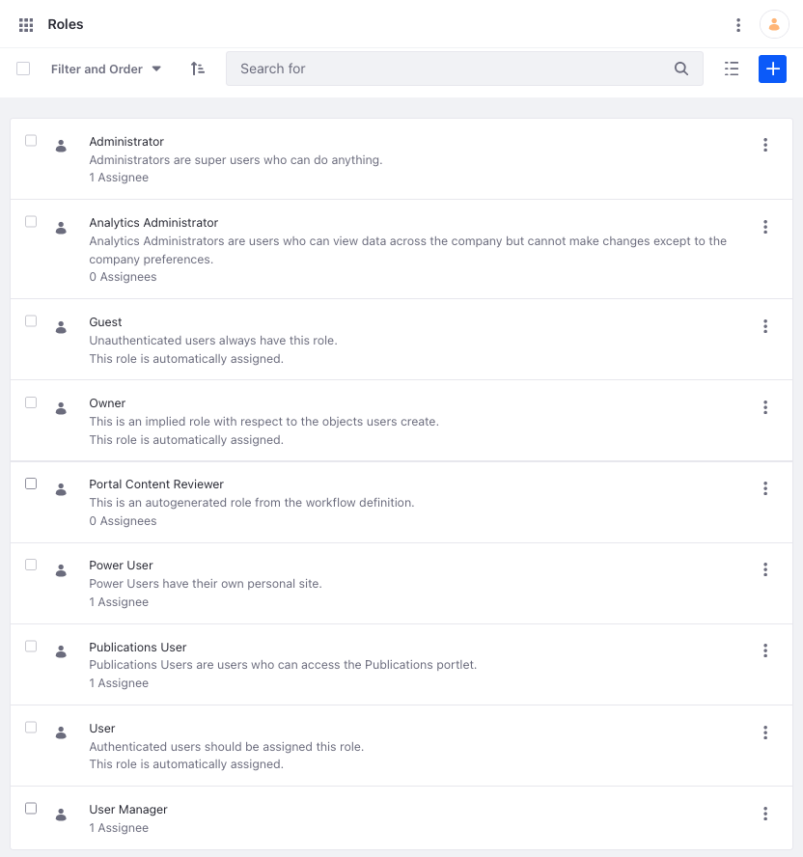
Role-Based Permission Framework
Liferay DXP uses the Role-Based Permissions Framework to manage User access to assets
Roles are created with the principle of least permissions in mind
To reduce unnecessary or unauthorized access, Users are granted Roles with only the fewest required permissions
By default, new Users are given the “User” Role and must be assigned other Roles by the Administrator
Notes:
Notes:
Permissions and Roles are covered in greater detail in the module, “Add Users and Manage Permissions with Liferay DXP.”
By default, all Users are automatically given the Role “User.” In most cases, this grants the Users permission to view a Site, Pages, and the User’s individual account.

Slide 28
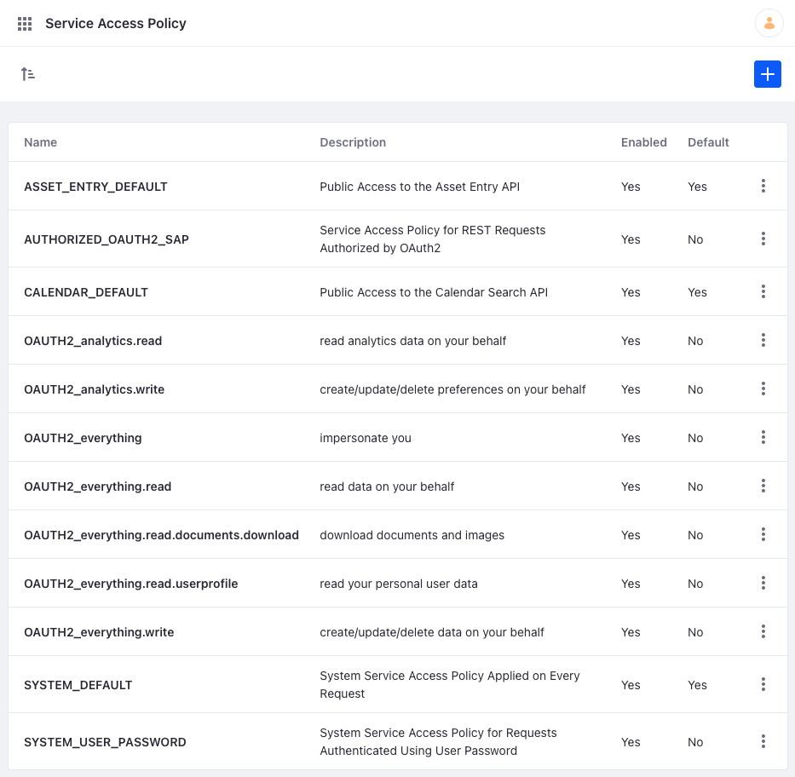
Service Access Policies
Service Access Policies define what services or service methods can be invoked remotely
Service Access Policies respect the permissions system
Keep in mind, Service Access Policy:
Names must be unique per portal instance
Names can only include certain characters
Titles, but not names, can be localized
Service signatures are entered one per line
Notes:
Notes:
Service Access Policies define the classes and methods that are allowed. You can manage them under Control Panel > Security > Service Access Policy.
Twelver Service Access Policies are enabled by default, including five related to the system:
ASSET_ENTRY_DEFAULT: updates the view counter for an asset when the asset is retrieved
AUTHORIZED_OAUTH2_SAP: allows all REST requests authorized by OAuth 2
CALENDAR_DEFAULT: makes it possible to search public events in the calendar
SYSTEM_DEFAULT: allows access to country/region services by JavaScript calls so Users can switch languages
SYSTEM_USER_PASSWORD: allows any method to be invoked (so long as the User has the required permission)
The other seven policies relate to OAuth and JSON web services.

Slide 29
Authentication Verifiers
Authentication Verifiers have two main responsibilities:
Verify provided credentials using registered AuthVerifier instances
Create portal authorization contexts based on verification results
Authentication Verifiers that ship with Liferay DXP include:
Basic Auth Header
Digest Authentication
HTTP Tunnel Extender
Image Request
Portal Sessions
Request Parameter
Tunnel Auth
Notes:
Notes:
Authentication Verifiers authenticate remote invocations of Liferay’s API in a centralized and extensible way.
Authentication verifiers focus on verifying authentication not providing credentials. It does not issue tokens or credentials or display the Sign In widget.
Essentially, the authentication verification layer is a border between authentication and authorization.

Slide 30
Cross-Origin Resource Sharing
Cross-Origin Resource Sharing (CORS) can be configured to enable resource retrieval from trusted sources only
Origin: a web server at a different domain
Resource: an asset stored on the server
Cross-Origin Request: requesting resources stored on another origin
Notes:
Notes:
CORS is enabled for Liferay DXP services under Control Panel > Configuration > System Settings > Security > Security Tools > Portal Cross-Origin Resource Sharing.
To configure CORS for JAX-RS Applications, go to Web Context Resource Origin Sharing (CORS) under Security Tools.

Slide 31
Use Case: Mondego Web Services
Mondego needs HR personnel to be able to access employee documents and company policies. To keep non-HR personnel from accessing this content, the system administrators can use Roles and Permissions to limit or extend User access to certain documents and Sites.
One of the Web Teams at Mondego uses an external server to host a collection of resources. By setting up Cross-Origin Resource Sharing, Mondego enables that team to retrieve only those approved resources.

Slide 32
Knowledge Check
Mondego needs robust security for its system, and Liferay DXP has four security layers for web services:
IP Permission Layer
Service Access Policy Layer
Authentication/Verification Layer
User Permission Layer
The Role-based Permissions Framework prevents users from accessing unauthorized content on Mondego’s Sites. To allow users to access resources hosted on another web server, Mondego can configure Cross-Origin Resource Sharing.

Slide 33
Knowledge Check
Mondego needs robust security for its system, and Liferay DXP has four security layers for web services:
IP Permission Layer
Service Access Policy Layer
Authentication/Verification Layer
User Permission Layer
The Role-based Permissions Framework prevents users from accessing unauthorized content on Mondego’s Sites. To allow users to access resources hosted on another web server, Mondego can configure Cross-Origin Resource Sharing.

Slide 34
Exercise: Set Up CORS/Service Access Policy (TBD)

Slide 35
Exercise Objectives
Brief breakdown of what you will be doing in the exercise
Additional exercise objective

Slide 36
Exercise Steps
Section Titles of Exercise Files
Broad Overview of Exercise
Not a Step-By-Step Walkthrough

Slide 37
Bonus Exercises
Section Titles of Exercise Files
Broad Overview of Exercise
Not a Step-By-Step Walkthrough

Slide 38
Securing Content and Fine-Tuning Security

Slide 39
Fine-Tuning Security
Portal Properties are used to fine-tune security features in Liferay DXP
Features that can be configured include:
Liferay Portal’s HTTPS web server address
The list of allowed servers to which Users can be redirected
The list of portlets that can be accessed from any page
The file types allowed to be uploaded and downloaded
Notes:
Notes:
Users have a great deal of flexibility when it comes to fine-tuning or disabling security features. However, it is important to exercise caution when configuring or altering default security settings to avoid an insecure system.
Additional information on security can be found in the Liferay Security Statement, and additional security plugins can be found on the Liferay Marketplace
Use Case:
As it starts creating its platform with Liferay, Mondego has a checklist of features and elements that need robust security. The security team can fine-tune additional security features as needed to ensure that the platform remains safe, no insecure or malicious content is uploaded, and everything deploys successfully.

Slide 40
AntiSamy
In Liferay DXP, the AntiSamy module protects against user-entered malicious code on blogs, message boards, and other applications that allow users to post content
The AntiSamy Sanitizer is used to define entities that should be sanitized or not sanitized:
Blacklist filters the designated content type
Whitelist prevents the content type from being filtered
Wildcards can also be used to configure AntiSamy to sanitize only one part of Liferay DXP and nothing else
Notes:
Notes:
AntiSamy works by adding package paths to the appropriate list (sanitized or not sanitized). The module then filters HTML/CSS fragments and removes suspect JavaScript.
Wildcards can be used to sanitize only one part of DXP, such as message boards. This is accomplished by using an asterisk (*), For example:
Set the whitelist to * and the blacklist to com.liferay.message.boards.*
AntiSamy Sanitizer by Class Name is another way for developers to configure AntiSamy. Developers specify an AntiSamy configuration XML file for each model class name
Use Case:
Mondego hosts a blog on one of its Sites. In order to ensure that guests leaving comments do not upload any malicious code, Mondego can configure AntiSamy to sanitize the blog comments.

Slide 41
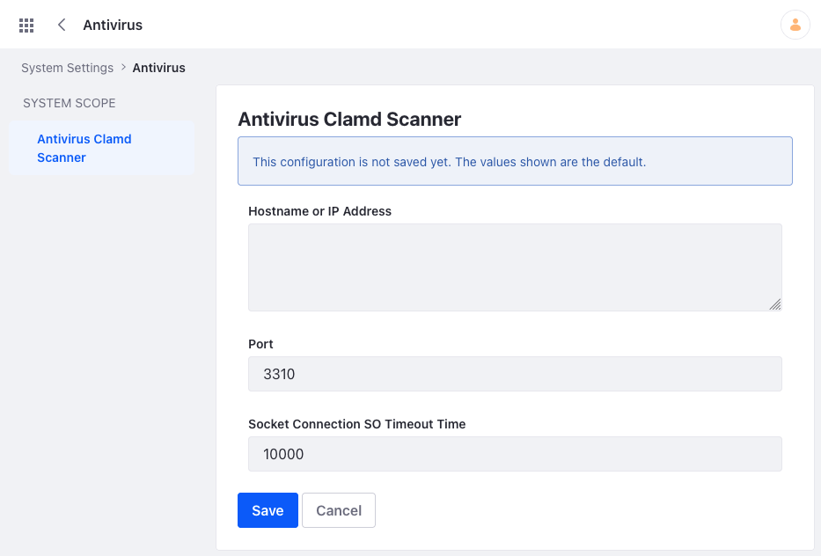
Enabling Antivirus Scanning for File Upload
Another layer for securing Files in Liferay DXP is the antivirus scanner
Enabling the antivirus scanner checks all files uploaded to Liferay for viruses, automatically rejecting them if one is detected
Liferay integrates with the ClamAC Daemon (Clamd), which is configured and (for optimal performance) run on a separate server
Notes:
Notes:
To enable the antivirus scanner:
First, configure and start Clamd on a separate server from your Liferay instance
Then, enable antivirus for your File Store by setting a portal property or Docker environment variable
Next, start the Liferay server
Under Control Panel > System Settings > Antivirus locate the Antivirus Clamd Scanner and add the hostname or IP address, port, and connection timeout time
Use Case:
Mondego requires its Users to submit a variety of documents to verify their accounts or account information. To ensure that these files are secure and will not damage the Mondego system, Mondego can enable the Clamd scanner to check every document or file users upload to the platform.

Slide 42
Securing Elasticsearch
The default search engine in Liferay DXP is Elasticsearch
After installing and connecting Elasticsearch, the search engine is secured by:
Enabling X-Pack Security and setting up X-Pack Users
Enabling Transport Layer Security (TLS) by generating and applying node certificates and keys
Once everything is set up, security can be configured in Liferay DXP by entering property values or using a configuration file
Notes:
Notes:
As with several of the other security features on Liferay DXP, Elasticsearch is run from a separate server. To run Liferay securely, you must install the Basic level of Elasticsearch at a minimum.
To configure search security in Liferay DXP, go to Control Panel > System Settings > Platform > Search. Select Elasticsearch 7 for 7.3+. The steps for earlier versions of Liferay differ, but information can be found on the Documentation site.
Use Case:
With any software, security is vital to prevent a server or data breach. Because Mondego needs a search function on its Sites, securing Elasticsearch is another important step to protect sensitive data.

Slide 43
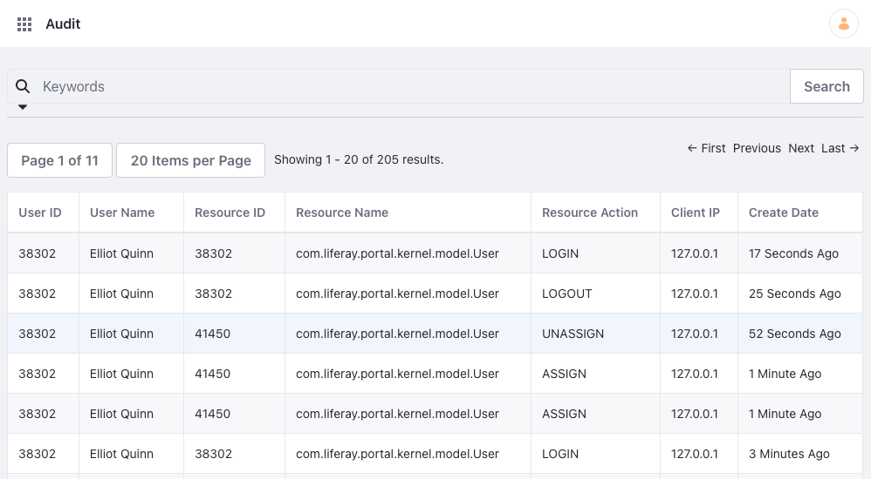
Audit
The Audit section provides a log of actions taken on the system, allowing the system administrators to determine what instance and request an event belongs to
Audit features and settings are managed under System Settings
Notes:
Notes:
Each item listed on the Audit page can be selected for additional details about the event.
To manage Audit settings, navigate to Control Panel > System Settings > Security > Audit. Here, you can configure settings for:
Audit
CSV Log Message
Logging Message Audit Message Processor
Persistent Message Audit Message Processor
Audit Log Context
Use Case:
The Audit tool allows Mondego to monitor activity and events on the system. In the case of any problems or security issues, this can help the Administrator determine the origin of an issue.

Slide 44
Use Case: Securing Content on Mondego Sites
The Mondego Group has several Sites that feature blogs, message boards, forums, submissions forms, and other places where Users can post content or upload files. To prevent any security breaches Mondego can:
Configure AntiSamy to sanitize blogs and message boards
Enable Antivirus scanning to check all uploaded files for viruses
If the Mondego system administrators encounter any unusual activity, they can determine the source using Audit.

Slide 45
Knowledge Check
The AntiSamy module is enabled on Mondego Sites to sanitize message boards and blogs in case Users post content with malicious code.
New Mondego customers fill out a form that includes a field for file upload. To ensure that no dangerous files are uploaded, the ClamAC Daemon antivirus scanner must be enabled.
The Mondego system administrator can check the system logs under Audit to verify activity on the system.
Mondego can also fine-tune security using Portal Properties and by properly configuring and securing applications, like the Elasticsearch search engine.

Slide 46
Knowledge Check
The AntiSamy module is enabled on Mondego Sites to sanitize message boards and blogs in case Users post content with malicious code.
New Mondego customers fill out a form that includes a field for file upload. To ensure that no dangerous files are uploaded, the ClamAC Daemon antivirus scanner must be enabled.
The Mondego system administrator can check the system logs under Audit to verify activity on the system.
Mondego can also fine-tune security using Portal Properties and by properly configuring and securing applications, like the Elasticsearch search engine.

Slide 47
Exercise: Exercise Title
Notes:
Exercise Title
Use this slide to indicate that the following slides outline an exercise associated with the topic that is being covered. If a topic has multiple associated exercises, place one of these slides before the first exercise and between each of the subsequent exercises.

Slide 48
Exercise Objectives
Brief breakdown of what you will be doing in the exercise
Additional exercise objective

Slide 49
Exercise Steps
Section Titles of Exercise Files
Broad Overview of Exercise
Not a Step-By-Step Walkthrough

Slide 50
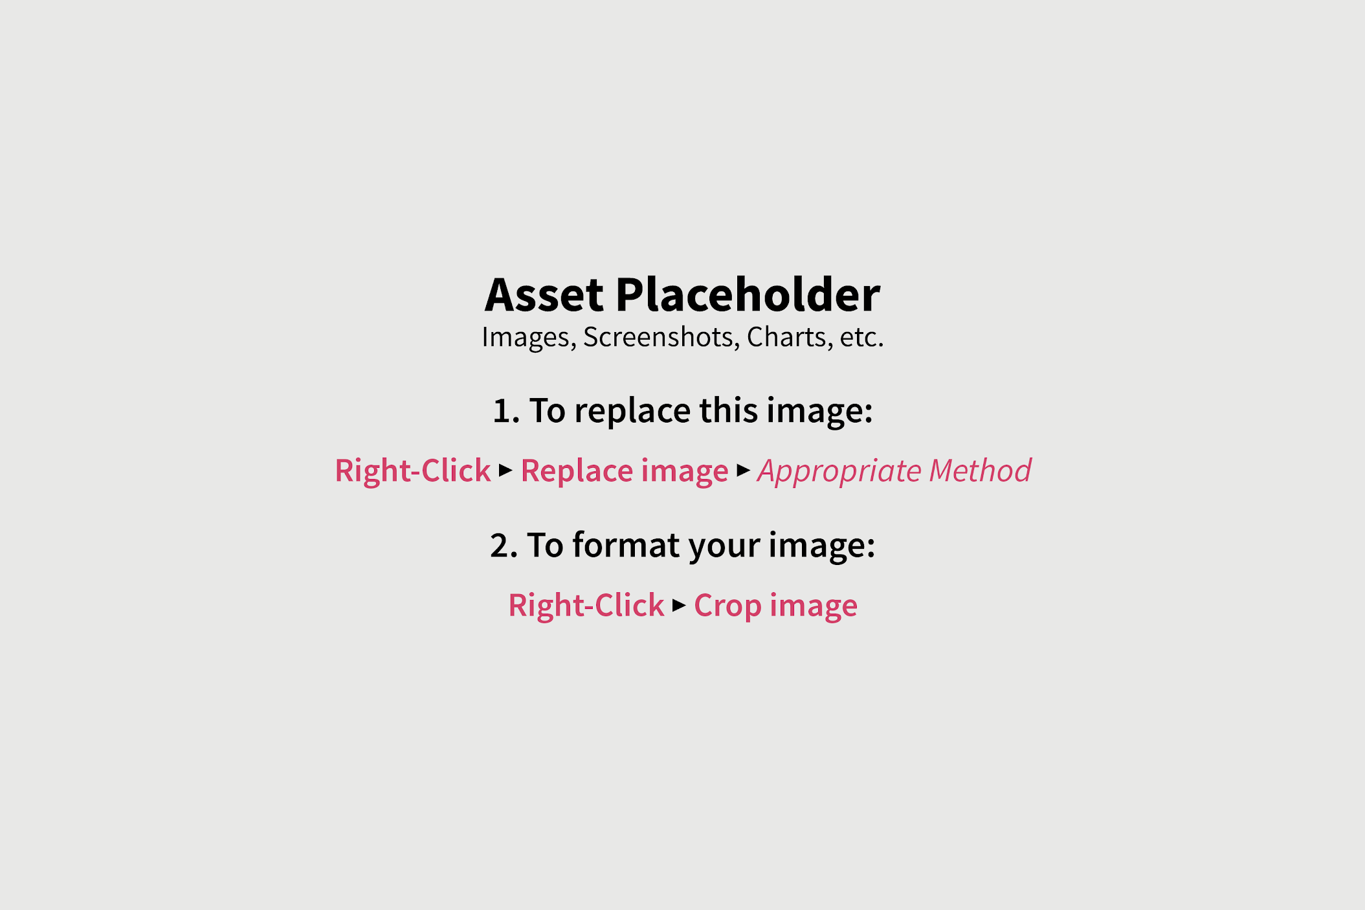
Alternate Exercise Steps
Section Titles of Exercise Files
Broad Overview of Exercise
Not a Step-By-Step Walkthrough
Notes:
Use this layout if the exercise outcome is clarified through the use of an image.

Slide 51

Demo Exercise Steps
Brief Overview of What is Being Shown
Not a Step-By-Step Walkthrough
Notes:
Use this layout for exercises that will be demonstrated by a trainer rather than performed by students.

Slide 52
Bonus Exercises
Section Titles of Exercise Files
Broad Overview of Exercise
Not a Step-By-Step Walkthrough

Slide 53
Summary (1/3)
Liferay DXP provides several options for Authenticating Users, including the Sign In Widget, importing Users from an LDAP server, and configuring Single Sign On or Multi-Factor Authentication methods.
For additional security, Liferay DXP includes email verification and reminder query settings. CAPTCHA and reCAPTCHA can be enabled to deter bots.
Password Policies require that User passwords meet the established rules for syntax, changes, and expiration.

Slide 54
Summary (2/3)
Liferay DXP provides four security layers for web services: IP Permission layer, Service Access layer, Authentication/Verification layer, and User Permission layer.
The Role-based Permission Framework, Authentication Verifiers, Service Access Policies, and Cross-Origin Resource Sharing are used to manage access in the system and from the system to external sources.

Slide 55
Summary (3/3)
AntiSamy adds additional security by protecting the Liferay platform from user-entered malicious doe on blogs, message boards, and other applications that accept user-posted content.
Enabling the ClamAV Daemon antivirus scanner protects the system by rejecting any file uploads that contain viruses.
Securing Elasticsearch, fine-tuning security settings, and monitoring the Audit system logs also helps to reduce security breaches and risks.

Slide 56
For Further Reading
For more information on securing Liferay DXP, consult the documentation here:
https://learn.liferay.com/dxp/latest/en/installation-and-upgrades/securing-liferay.html
For general questions about using Liferay’s products, visit:
https://learn.liferay.com/
Notes:
Note: Currently learn.liferay.com contains documentation resources for DXP 7.3+, DXP Cloud, Liferay Commerce, and Analytics Cloud. If additional information is needed, especially on earlier versions of DXP and Liferay Portal, include the appropriate help.liferay.com link to the topic’s documentation.

